Slide 1
Employee Management Platform
Streamlining workforce administration and HR processes

Slide 2
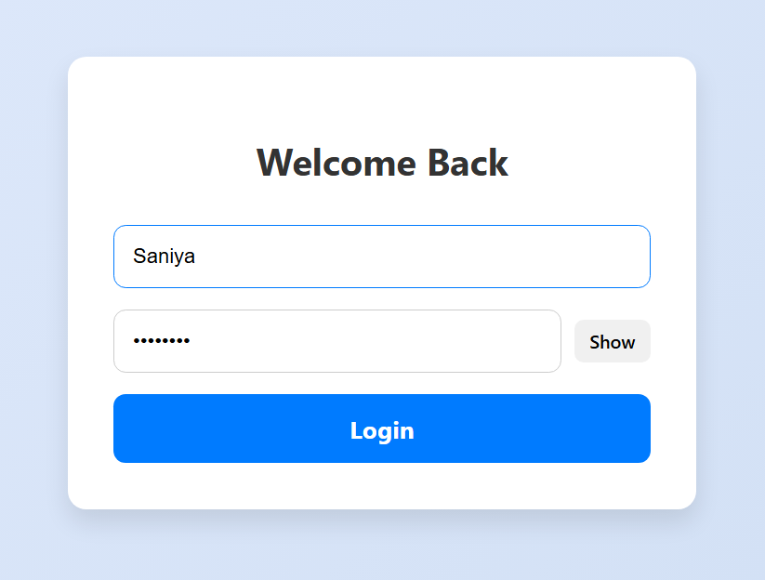
Introduction to Employee Management Platform
Comprehensive Web Application
The platform is a web-based application designed to efficiently manage employee and project data.
RESTful API Architecture
It uses RESTful APIs to enable full CRUD operations for seamless data manipulation and retrieval.
Backend Technology Stack
Spring Boot provides a robust backend framework, while PostgreSQL ensures reliable data storage.
Security Features
Spring Security is integrated for authentication and authorization to enhance platform security.
Notes:
The Employee Management Platform is a comprehensive web-based application built using Spring Boot and PostgreSQL. It is designed to manage employee and project data efficiently through a RESTful API architecture. The platform supports full CRUD (Create, Read, Update, Delete) operations for both Employee and Project entities, enabling seamless data manipulation and retrieval. The backend is powered by Spring Boot, which provides a robust and scalable framework for building enterprise-level applications. PostgreSQL serves as the relational database, ensuring reliable and structured data storage. The application also incorporates Spring Security for authentication and authorization, enhancing the overall security posture. This system is ideal for organizations looking to streamline their employee and project management processes through a modern and secure web interface.

Slide 3
Technical Architecture
Notes:
Architecture Overview

Slide 4

Architecture Overview
Core Backend System
The Spring Boot backend processes business logic, data handling, and API endpoint management efficiently.
REST Controllers
REST Controllers provide API endpoints to perform CRUD operations on Employee and Project entities.
Data Persistence Layer
Data persistence is handled using JPA with PostgreSQL database, mapping entities to tables.
Security Management
Spring Security enforces authentication, CORS, and CSRF protections to secure the platform.
Notes:
The architecture of the Employee Management Platform is layered and modular, comprising several key components. At the core is the Spring Boot backend, which handles business logic, data processing, and API endpoints. The REST Controllers expose endpoints for interacting with Employee and Project entities, supporting operations such as creation, retrieval, updating, and deletion. Data persistence is managed through JPA (Java Persistence API) with PostgreSQL as the underlying database. Entity classes are annotated to define relationships and mappings to database tables. Security is enforced using Spring Security, which includes configurations for CORS (Cross-Origin Resource Sharing), CSRF (Cross-Site Request Forgery) protection, and authentication management. The application also includes service layers that encapsulate business logic and interact with repositories. This architecture ensures scalability, maintainability, and security, making it suitable for enterprise deployment.

Slide 5
Entity Design
Notes:
Employee and Project Entities

Slide 6

Employee and Project Entities
Employee Entity Attributes
Employee entity includes ID, name, department, and other relevant details to represent staff members.
Project Entity Attributes
Project entity consists of project ID, name, description, and associated employees.
Entity Relationships
Many-to-Many mappings connect employees to projects ensuring data integrity.
Extensible Object-Oriented Design
Entity classes follow OOP best practices, allowing easy future extensions and integration.
Notes:
The platform defines two primary entities: Employee and Project. The Employee entity includes attributes such as ID, name, department, and other relevant details. The Project entity comprises fields like project ID, name, description, and associated employees. These entities are mapped to PostgreSQL tables using JPA annotations. Relationships between entities are established using One-to-Many or Many-to-Many mappings, depending on the business requirements. For example, an employee can be assigned to multiple projects, and a project can have multiple employees. These relationships are crucial for maintaining data integrity and enabling complex queries. The entity classes are designed to be extensible and follow best practices in object-oriented programming, ensuring that future enhancements can be easily integrated.

Slide 7
Database Schema
Notes:
PostgreSQL Integration

Slide 8

PostgreSQL Integration
Relational Database Structure
PostgreSQL stores data in tables with entities mapped via JPA annotations for structured relational management.
Entity Table Design
Employee and Project tables include key attributes and are linked through foreign keys and join tables.
Data Access Abstraction
Spring Data JPA repositories enable CRUD operations without explicit SQL, improving developer efficiency.
Performance and Features
The integration supports large data volumes with advanced features like pagination and sorting for efficiency.
Notes:
The Employee Management Platform uses PostgreSQL as its relational database system. Each entity is mapped to a corresponding table in the database using JPA annotations. The Employee table includes columns for ID, name, department, and other attributes, while the Project table contains fields for project ID, name, and description. Relationships between tables are defined using foreign keys and join tables, depending on the nature of the association. The database schema is designed to support efficient querying and data integrity. Spring Data JPA repositories are used to abstract database operations, allowing developers to perform CRUD operations without writing explicit SQL queries. This integration ensures that the application can handle large volumes of data reliably and supports advanced features like pagination and sorting.

Slide 9
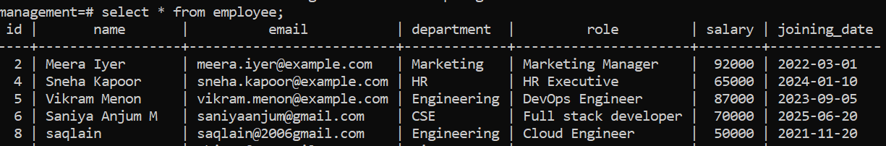
Employee and Project Table
Notes:
This slide is intended for showcasing the Employee table view. The screenshot should include a list of employees displayed in a tabular format, with columns for ID, name, department, and other relevant details. This view is essential for monitoring and managing employee data effectively.

Slide 10
Controller Operations
Notes:
CRUD and Search Functionality

Slide 11
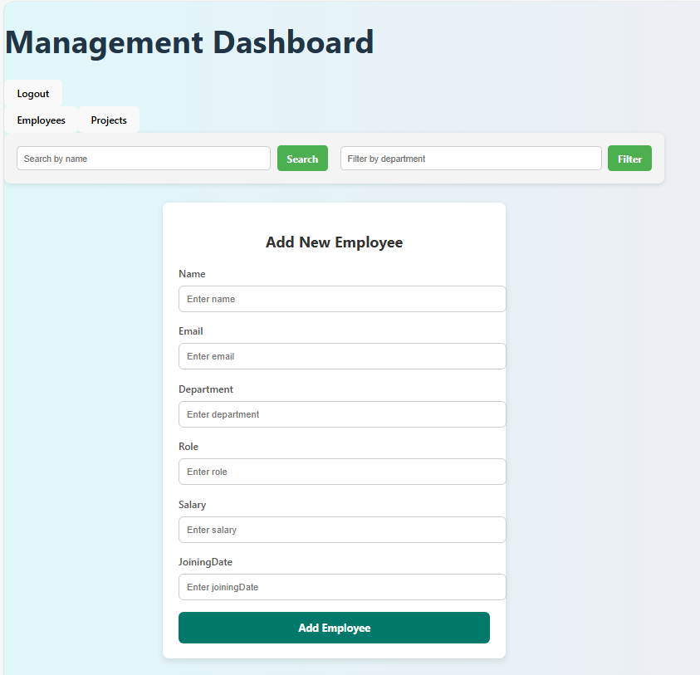
CRUD and Search Functionality
Employee Data Management
Supports adding, retrieving, updating, deleting employees and searching by name or filtering by department.
Project Data Management
Allows adding, updating, retrieving, and deleting project information using RESTful endpoints.
REST API Design
Endpoints use standard HTTP methods and annotations for clean, intuitive URL and request handling.
Notes:
The platform's REST controllers provide comprehensive endpoints for managing Employee and Project data. For Employees, the controller supports operations such as adding a new employee, retrieving all employees, updating employee details, deleting an employee, and searching by name or filtering by department. Similarly, the Project controller allows for adding new projects, updating existing ones, retrieving all projects, and deleting projects. These endpoints are mapped using standard HTTP methods like GET, POST, PUT, and DELETE. The controllers are annotated with @RestController and @RequestMapping to define URL paths and request handling. Input data is received via @RequestBody, and path variables are handled using @PathVariable. This design ensures a clean and intuitive API structure that can be easily consumed by frontend applications or other services.

Slide 12
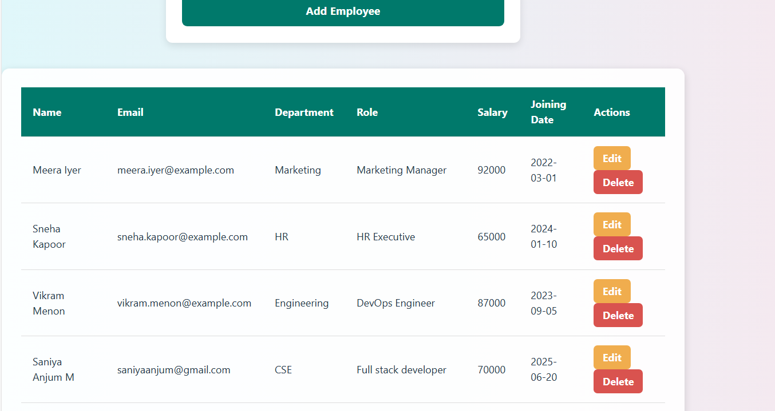
Employee List where you can Update or Delete the Employee Details

Slide 13
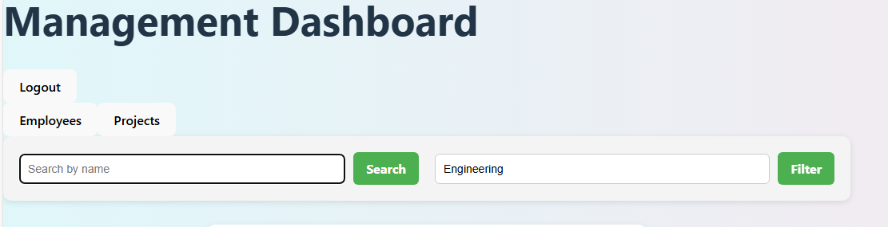
Search and Filter Operations Screenshot
Search Functionality
Users can quickly find employees by typing their name in the search bar, improving data retrieval speed.
Filter by Department
Filtering employees by department allows users to segment data easily for better organization and management.
Enhanced Usability
Search and filter features improve platform usability by enabling quick access to specific employee data subsets.
Notes:
This slide provides space for screenshots demonstrating the search and filter functionalities. It should show how users can search for employees by name or filter them by department. These features enhance the usability of the platform by allowing quick access to specific data subsets.

Slide 14
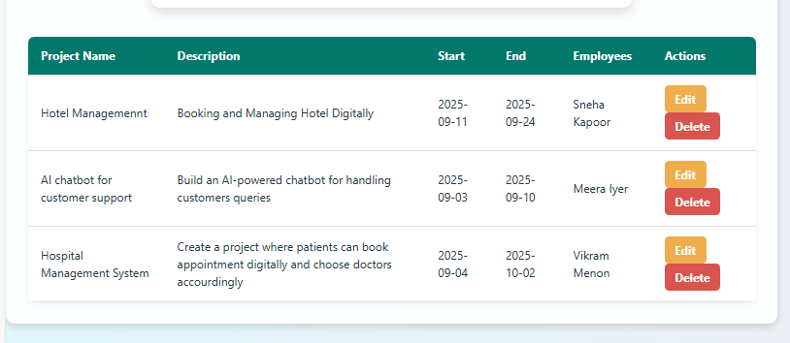
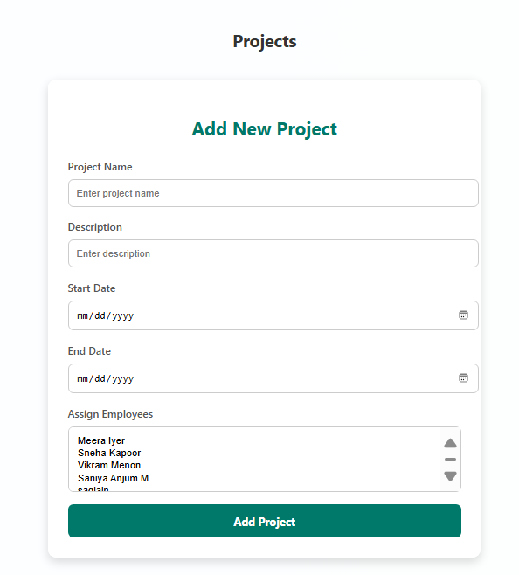
Add Project
Frontend Interface
Displays the form used to enter new project details for adding to the system.
Operation Confirmation
Shows the confirmation message or updated data view after adding an project and assigning to employee.
Notes:
This slide is reserved for inserting a screenshot of the Add Employee operation. It should display the frontend interface where a new employee is added, along with the resulting confirmation or data view. This visual representation helps in understanding the user interaction and verifying the functionality of the add operation.

Slide 15
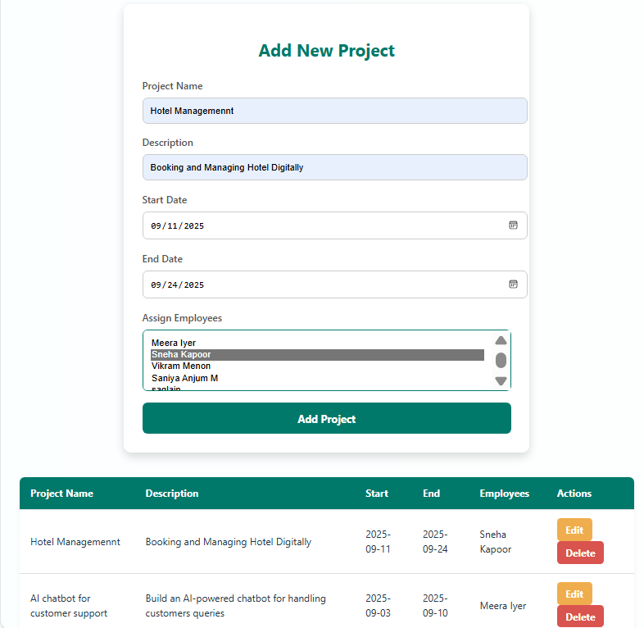
Add and Assign Project
Project Creation Interface
The interface allows users to add new projects easily with input fields for project details.
Employee Assignment Workflow
The workflow enables assigning employees to projects for clear resource tracking and allocation.
Resource Management Importance
Tracking project involvement and allocation improves team productivity and project outcomes.
Notes:
This slide is designated for screenshots related to adding a new project and assigning it to employees. It should illustrate the interface and workflow for project creation and employee assignment. This functionality is crucial for tracking project involvement and resource allocation.

Slide 16
Security Configuration
Notes:
Spring Security Setup

Slide 17

Spring Security Setup
Authentication and Authorization
Spring Security manages user authentication and authorization to protect application resources from unauthorized access.
Security Configuration Beans
SecurityConfig class defines SecurityFilterChain, PasswordEncoder with BCrypt, and AuthenticationManager beans for secure operations.
CSRF and CORS Settings
CSRF protection is disabled during development; CORS is configured to allow frontend requests from localhost for testing.
Login Handling and Security Context
AuthController authenticates user credentials and sets the security context to enable secure login functionality.
Notes:
Security is a critical aspect of the Employee Management Platform. The application uses Spring Security to manage authentication and authorization. The SecurityConfig class defines beans for SecurityFilterChain, PasswordEncoder, and AuthenticationManager. CSRF protection is disabled for development purposes, and CORS is configured to allow requests from the frontend hosted at http://localhost:5173. The PasswordEncoder bean uses BCrypt for secure password hashing. AuthenticationManager is exposed as a bean to facilitate login operations. The AuthController handles login requests by authenticating user credentials and setting the security context. These configurations ensure that only authenticated users can access protected resources and that user data is handled securely.

Slide 18
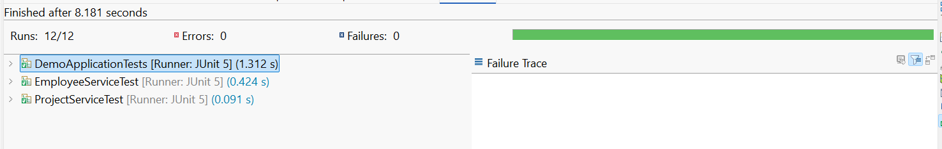
JUnit Testing for Service Layer
Validating Business Logic
JUnit tests verify the correctness of business logic in adding, updating, and deleting employees or projects.
Ensuring Code Reliability
Unit testing helps in maintaining code reliability and stability throughout the development lifecycle.
Early Issue Identification
JUnit tests help identify bugs and issues early, reducing risks and improving software quality.
Notes:
This slide is meant for displaying JUnit test results for the service layer. It should include screenshots or summaries of test cases validating business logic, such as adding, updating, and deleting employees or projects. Unit testing ensures code reliability and helps in identifying issues early in the development cycle.

Slide 19
CONCLUSION
The Employee Management Platform presents a robust, scalable, and secure solution for managing workforce and project data in modern enterprises.
Built on a Spring Boot and PostgreSQL foundation, it offers full CRUD capabilities, intuitive RESTful APIs, and a modular architecture that ensures maintainability and extensibility.
The platform's emphasis on security through Spring Security, along with its user-friendly frontend and efficient backend operations, makes it ideal for streamlining HR and administrative workflows.
With features like search and filter, entity relationships, and JUnit-tested service layers, the system is well-equipped to support dynamic organizational needs and future enhancements.

Slide 20
THANK YOU

